Slide 1
polynomial regression
Nonlinear regression

Slide 3
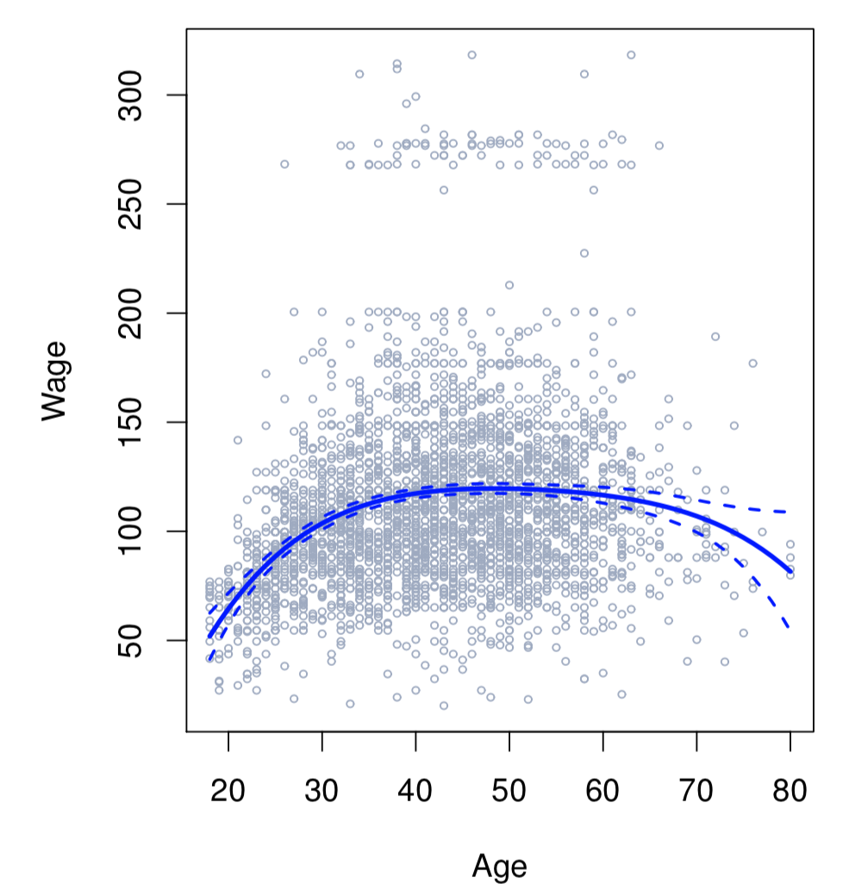

Slide 4
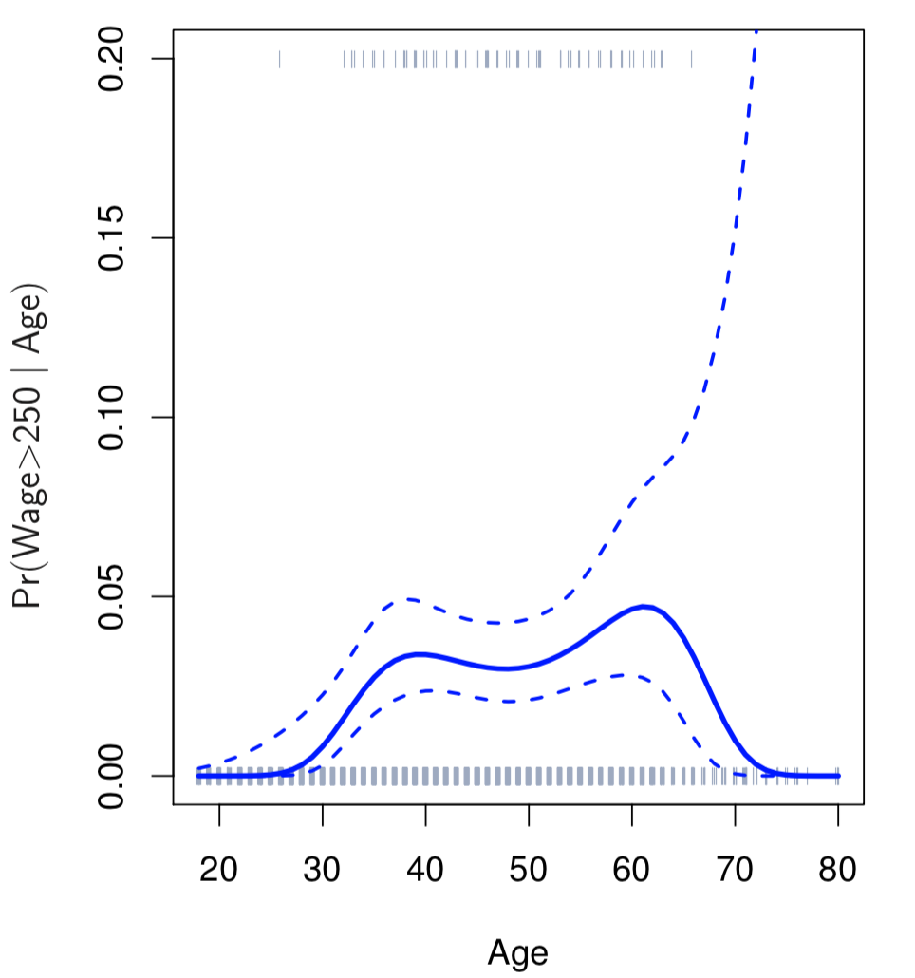

Slide 5
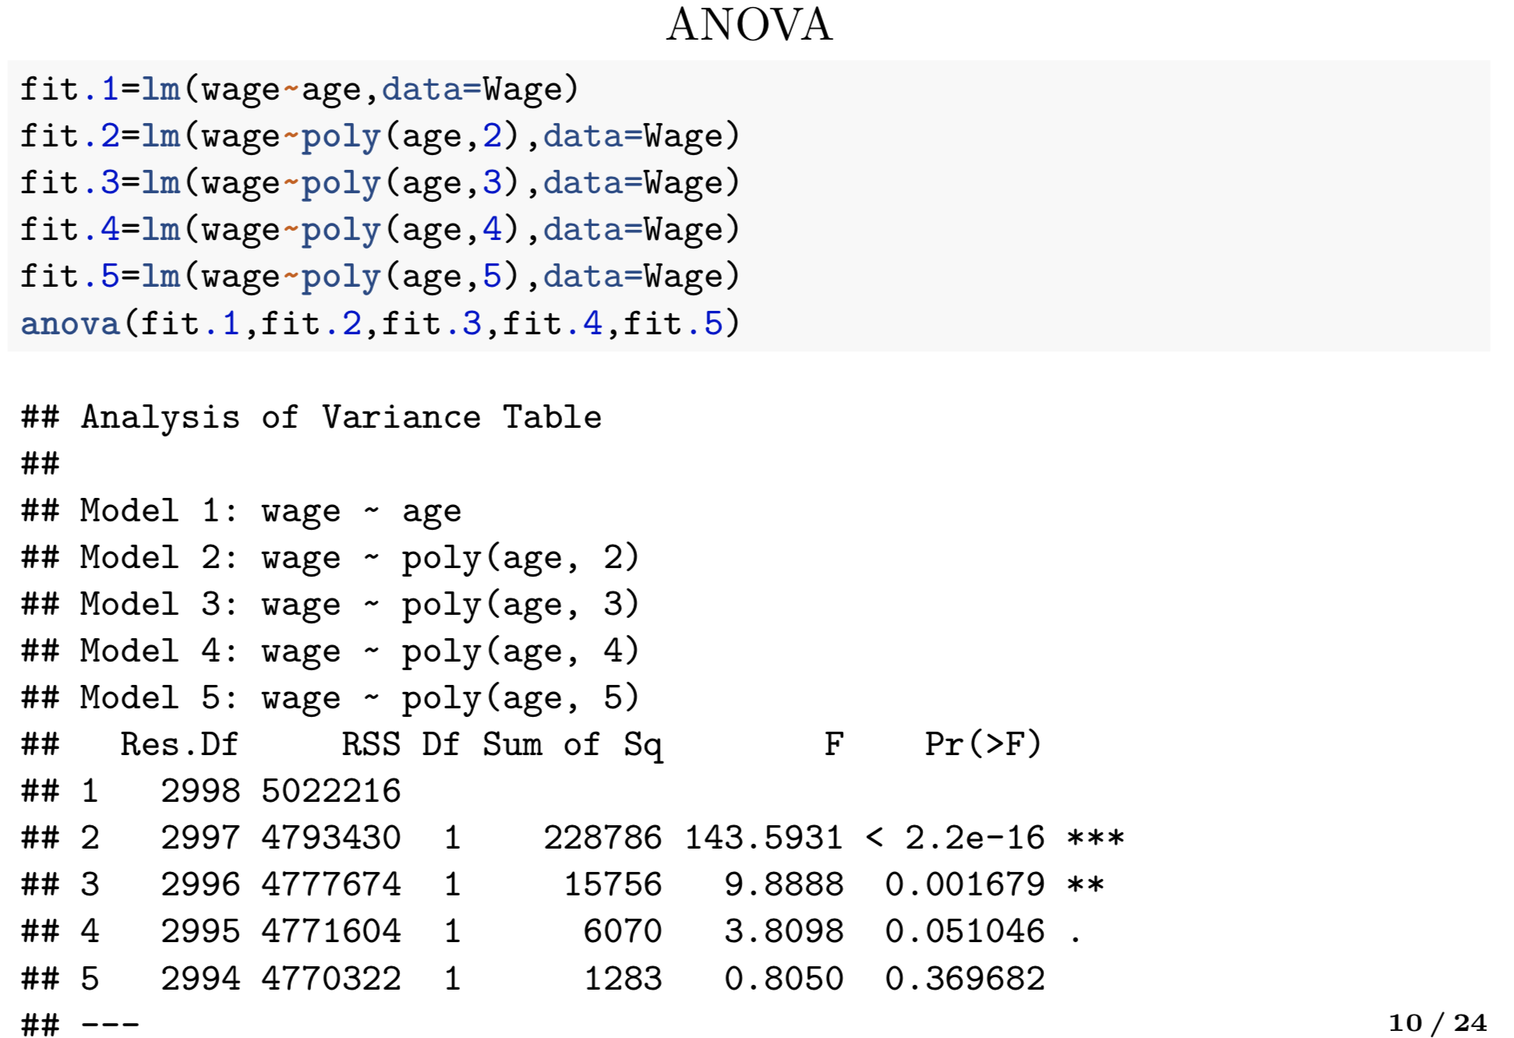
Tuning parameter to choose optimal d

Slide 6
Orthogonal polynomial regression

Slide 7
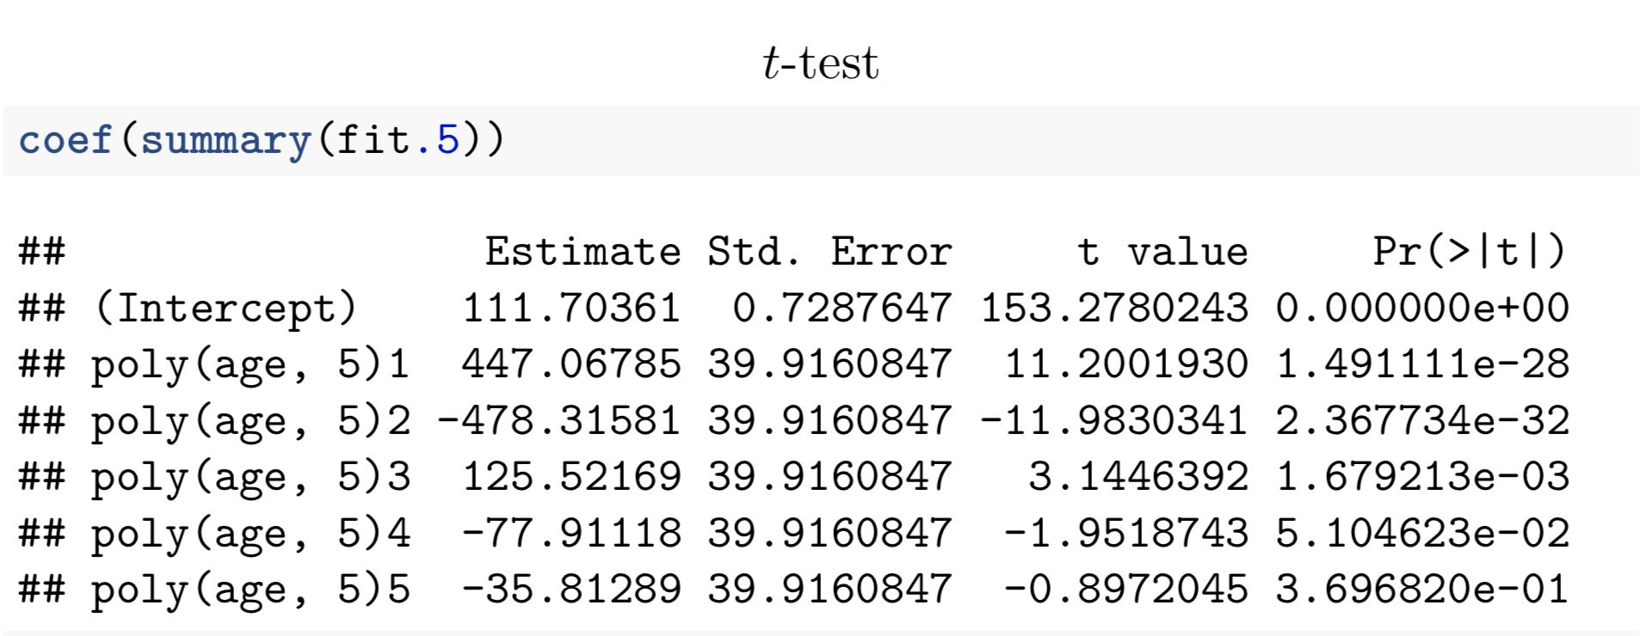
Orthogonal polynomial regression

